Slide 1
Assignments on Unit – II
(Data Link Control)

Slide 2
Lab Assignment on Unit II: (Use C/C++)
Write a program for error detection and correction for 7/8 bits ASCII codes using Hamming Codes or CRC.
Demonstrate the packets captured traces using Wireshark Packet Analyzer Tool for peer to peer mode.( 50% students will perform Hamming Code and others will perform CRC).

Slide 3
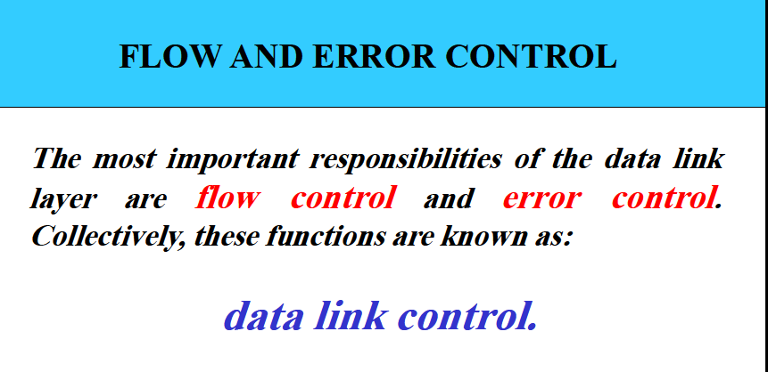

Slide 4
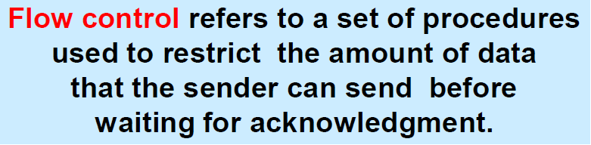
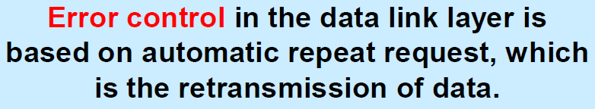
Flow & Error Control

Slide 5
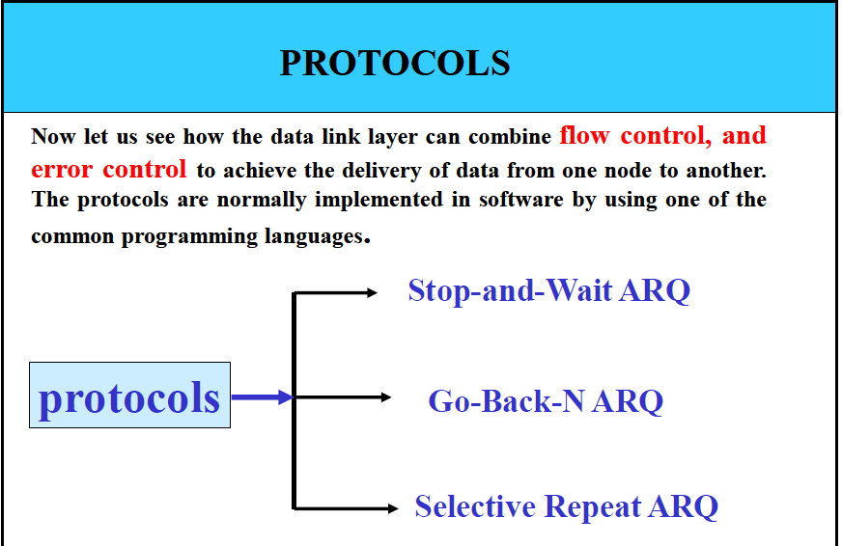

Slide 6
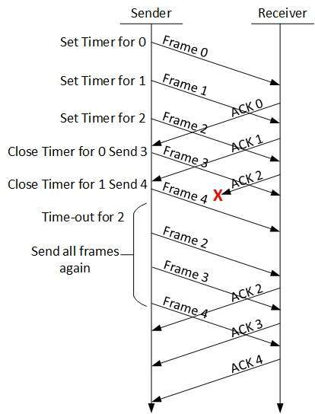
1. Go-Back-N ARQ
The size of the window is at most 2^{m} -1 where m is the number of bits for the sequence number.
If m = 3, sequence numbers are range from 0 to 7 (8 numbers)
If sender finds that it has received NACK , it retransmits all the frames after which it does not receive any positive ACK.

Slide 7
Problem Statement (Simple to Hard)
4. Lab Assignment on Unit II: (Use JAVA/PYTHON)
Write a program to simulate Go back N and Selective Repeat Modes of Sliding Window Protocol in peer to peer mode and demonstrate the packets captured traces using Wireshark Packet Analyzer Tool for peer to peer mode.
3. Lab Assignment on Unit II: (Use C/C++)
Write a program for error detection and correction for 7/8 bits ASCII codes using Hamming Codes or CRC. Demonstrate the packets captured traces using Wireshark Packet Analyzer Tool for peer to peer mode.( 50% students will perform Hamming Code and others will perform CRC)

Slide 8
Go-Back-N ARQ Program
testclient.java
testserver.java
First Execute testserver.java in order to setup a connection with client
Then Execute testclient.java
Test this program by using 2 conditions with & without error

Slide 9
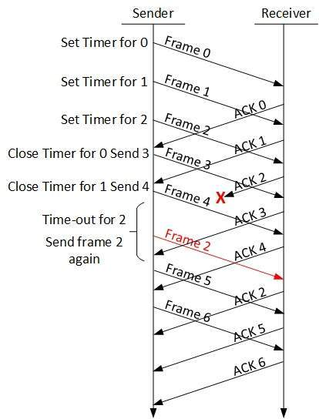
2. Selective Repeat ARQ
In Go-Back-N resending consumes more bandwidth & slow down the transmission
In Selective Repeat ARQ, only the damaged frame is resent.
More bandwidth efficient but more complex processing at receiver.

Slide 10
Selective Repeat Program
client.java
server.java
First Execute server.java in order to setup a connection with client
Then Execute client.java
In this program I have used fix no. of frames.

Slide 11
Cyclic Redundancy Check: CRC
Given a k-bit frame or message, the transmitter generates an n-bit sequence, known as a frame check sequence (FCS), so that the resulting frame, consisting of (k+n) bits, is exactly divisible by some predetermined number.
The receiver then divides the incoming frame by the same number and, if there is no remainder, assumes that there was no error.

Slide 12
Binary Division
Here Degree of polynomial is 3 that’s why 3 zeros are added at the end of transmitting bits

Slide 13
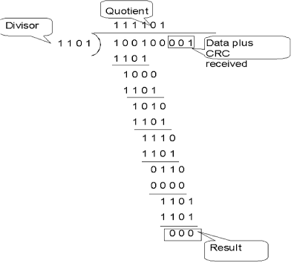
At the receiver side

Slide 14

Hamming Code
Hamming codes are a family of linear error-correcting codes that generalize the Hamming(7,4)-code
Invented by Richard Hamming in 1950
Hamming codes can detect up to two-bit errors or correct one-bit errors without detection of uncorrected errors

Slide 15
Hamming Code
Data bits:- 4 bits of data that we want to transmit
Parity bits:- Extra bits stream that we put in data bits in order to detect error.
Position of parity bit is 2^{n} where {n=0,1,3…n}
2⁰ = P1
2¹ = P2
2² = P4
2³ = p8
2⁴ = P16
.
.
P8 | D7 | D6 | D5 | P4 | D3 | P2 | P1

Slide 16
Parity Bit
A single bit is appended to each data chunk
makes the number of 1 bits even/odd
Example: even parity
1000000(1)
1111101(0)
1001001(1)
Example: odd parity
1000000(0)
1111101(1)
1001001(0)
Notes:
single parity check code can detect only odd number of errors in a code word.
An observation of the table reveals that to move from one code word to another, at least two data bits should be changed. Hence these set of code words are said to have a minimum distance (hamming distance) of 2, which means that a receiver that has knowledge of the code word set can detect all single bit errors in each code word. However, if two errors occur in the code word, it becomes another valid member of the set and the decoder will see only another valid code word and know nothing of the error. Thus errors in more than one bit cannot be detected. In fact it can be shown that a single parity check code can detect only odd number of errors in a code word.
<number>

Slide 17
How to calculate the value of P1,P2, P4??
P1= D3D5D7D9D11
P2 = D3D6D7D10D11
P4=D5D6D7….D12D13D14D15
For Example Data bits :- 1011 calculate the value of P1P2 & P4.
Put the data values and calculate
P1= D3D5D7D9D11 …..
(1) 1 1 1 --------Odd Parity P1 =1
P2 = D3D6D7D10D11
(0) 1 0 1 --- Even Parity P2 = 0
P4=D5D6D7….D12D13D14D15
(0) 1 0 1 Even Parity P4 = 0
 | D7 | D6 | D5 | P4 | D3 | P2 | P1
 | 1 | 0 | 1 |  | 1 |  | 1

Slide 18
Continue..
P1P2P4
100
Data transmitted from Transmitter to Receiver is 1010101
Data received at receiver side is 1110101. Now find out the in receiving data. Again calculate value of P1P2P4
P1= D3D5D7D9D11 …..
1 1 1 1 --------Even Parity ……..No Error
P2 = D3D6D7D10D11
0 1 1 1 --- Odd Parity P2 = 0 …………Error
P4=D5D6D7….D12D13D14D15
0 1 1 1 Odd Parity P4 = 0 …….Error

Slide 19
P1P2P4
011
P2 + P4
2+4 = 6
So the error is at sixth position D6= 1
1110101
If we make it 0 then it becomes even parity.
Correct bits are 1010101

Slide 20
Any Question???

Slide 21
Thank you all..

